Slide 1
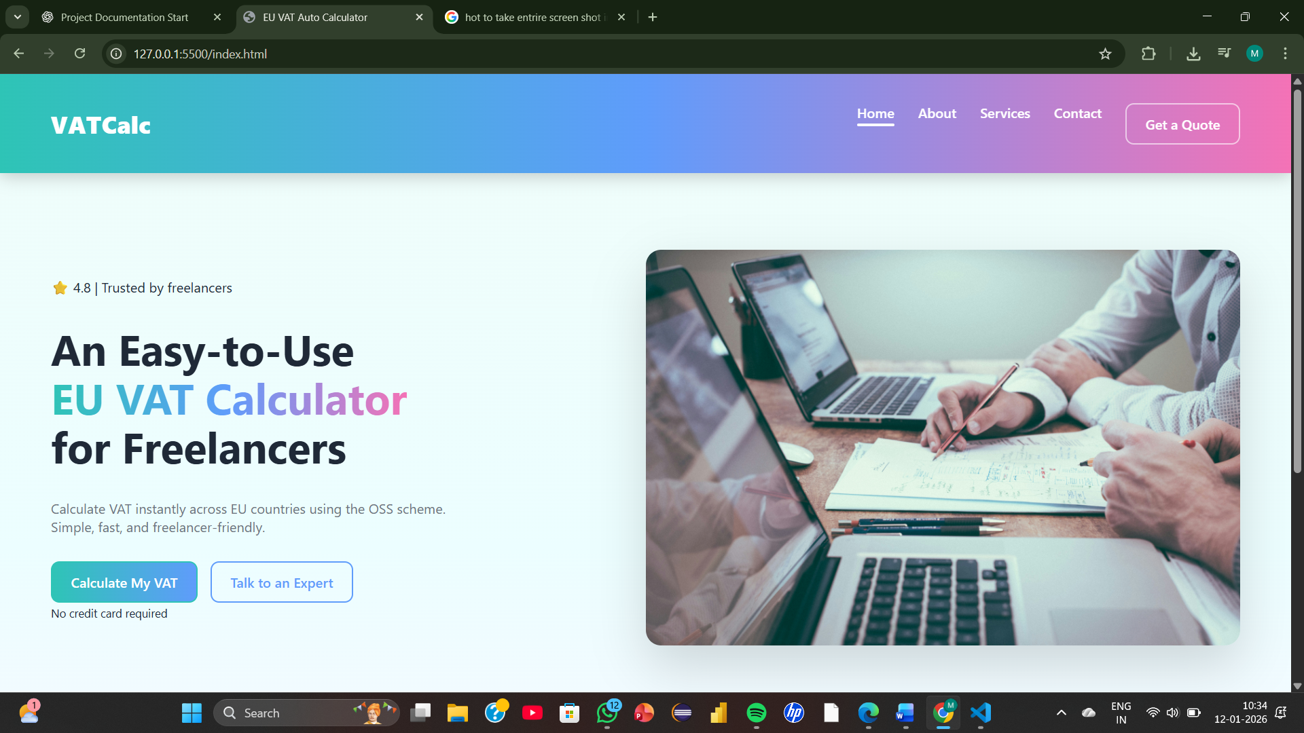

EU VAT Auto Calculator
-A SaaS Web Application for Freelancers
Presented by:
Medidhi Mounika

Slide 2


INTRO
EU VAT Auto Calculator
-A SaaS Web Application for Freelancers
It helps freelancers calculate VAT for EU clients
VAT rates differ across EU countries
Manual calculation is complex and error-prone
The system automatically applies the correct VAT rate
It provides instant and accurate results
It makes invoicing faster and more reliable
EU VAT Auto Calculator is a SaaS-based web application

Slide 3

01
Introduction
02
Client Side Demo
Problem Statement
Project Scope
Project Modules
Challenges & Methodologies
Run the project using link (hosted version).
Navigate and demonstrate the services
Agenda
03
Technical Demo
04
Conclusion
Show the functionalities.
Show the documentation part.
Show the integrations
Conclusion
Future Scope
References

Slide 4

Introduction
EU VAT Auto Calculator
-A SaaS Web Application for Freelancer
EU VAT Auto Calculator is a SaaS web application that helps freelancers calculate VAT for EU clients automatically. The system allows users to enter the service amount and select the client’s country, after which it fetches the correct VAT rate and displays the VAT and total amount instantly. This reduces manual effort, avoids calculation errors, and makes EU VAT-compliant invoicing simple and fast.

Slide 5

System Implementation Overview
01
Frontend Web Application HTML, CSS, JavaScript based UI
02
EU VAT API Integration Fetch real-time VAT rates
03
VAT Calculation Logic Apply formula using JavaScript
04
Instant Result Display Show VAT and total amount

Slide 6
Client Demo
Run app and demonstrate

Slide 7
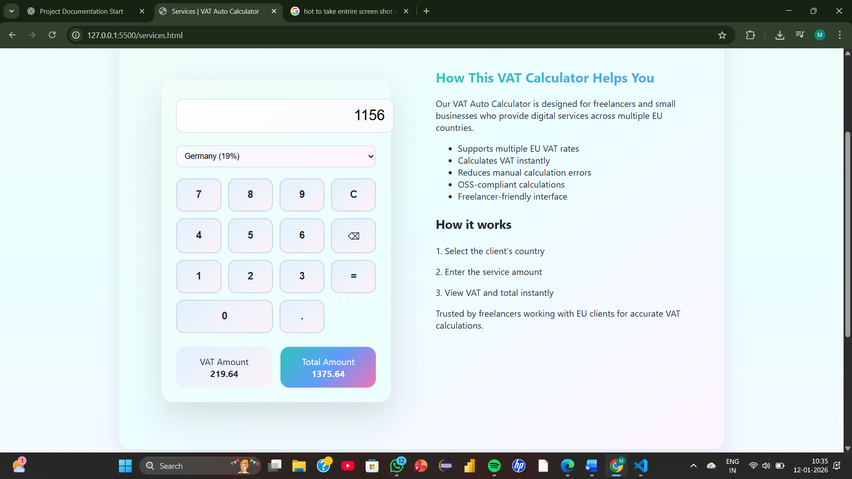
Visual Explanation
Client Demo – VAT Calculation
User enters invoice details and gets instant VAT and total amount

Slide 8
VAT Calculation System – Implementation Overview
01
Frontend Interface
The user enters the service amount and selects the client’s EU country using a simple and responsive web interface built with HTML and CSS.
02
VAT Rate API
The application sends a request to an EU VAT Rate API to fetch the correct VAT percentage for the selected country.
03
JavaScript Calculation
JavaScript applies the VAT formula to calculate the VAT amount and the total invoice value in real time.
04
Instant Output
The system displays the VAT amount and total payable value instantly without reloading the page.

Slide 9
Technical Demo
Source Code – Integration - Documentation

Slide 10
Technical Implementation Details
01
API Integration EU VAT API is used to retrieve real-time VAT rates for different countries.
02
Form Handling HTML input fields and dropdowns capture the invoice amount and country.
03
Calculation Engine JavaScript calculates VAT and total using mathematical formulas.
04
Dynamic Display Results are updated instantly on the webpage without refresh.

Slide 11
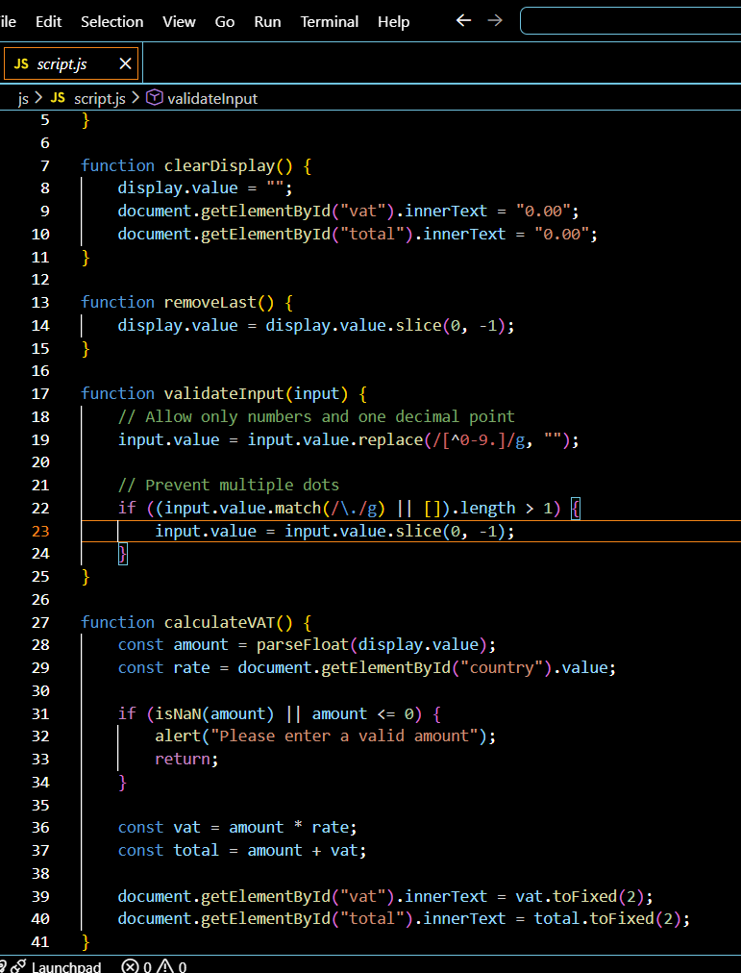
Technical Demo
Technical Demo – VAT Calculation
JavaScript fetches VAT rates from an EU API and calculates VAT and total amount in real time.

Slide 12

Conclusion
Provides an easy and accurate VAT calculation solution
Reduces manual effort and calculation errors
Uses real-time EU VAT rate API
Works as a lightweight SaaS web application
Accessible from any device using a browser
Helps freelancers generate compliant invoices

Slide 13
THANK YOU

